Slide 1

NSG Pilkington – University of Liverpool Machine Learning Project: 31/03/2021
Dr. Peter Green
Diego Echeverria
Sarini Jayasinghe
Risk Institute,
School of Engineering

Slide 2
Today’s Presentation
Online processing of furnace faults
Processing Engineering Limits (1)
Processing Engineering Limits (2)
Important inputs
Mark 4 data filtering
Estimating time lags
Linear Dynamical System
Next steps?

Slide 3
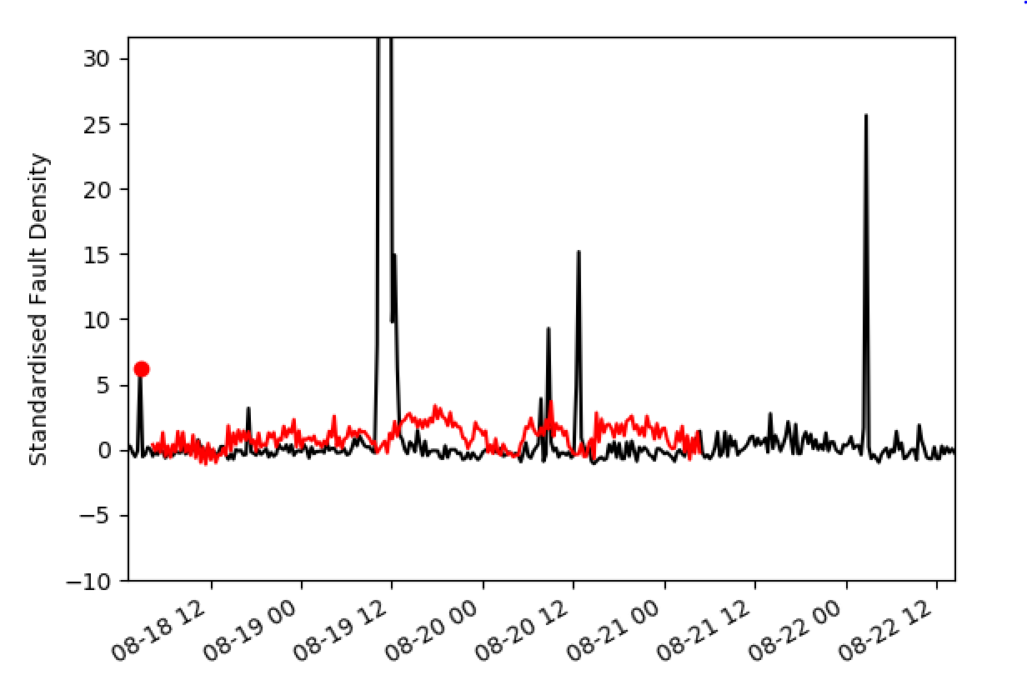
Online Processing of Furnace Faults
Algorithm now detects and deliberately ignores spikes (these come up as red dots in the video).
Here it simply ignores data that is more than 5 beyond the model’s predictions.
We get better results doing this than when we use the post-processed fault density data.

Slide 4
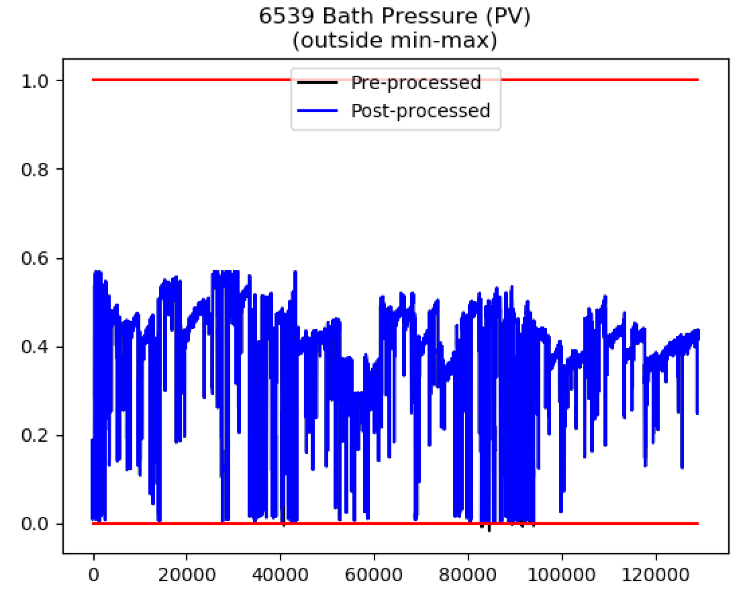
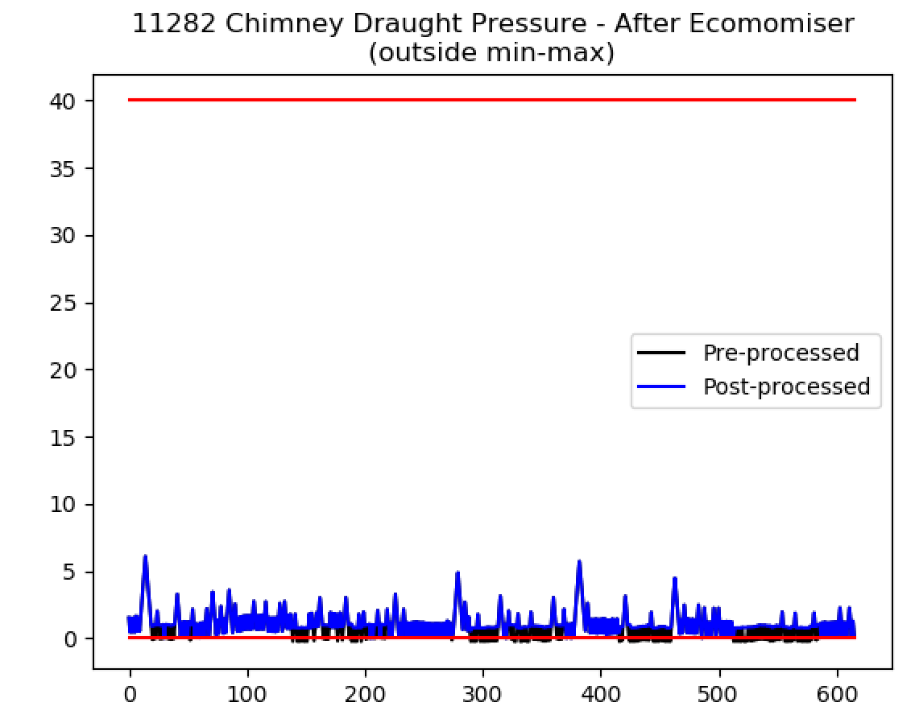
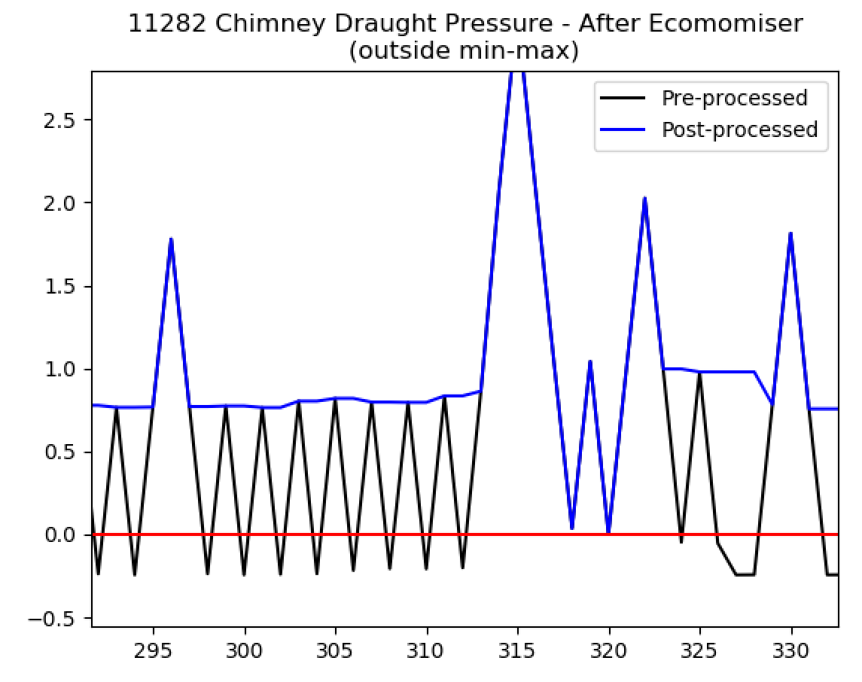
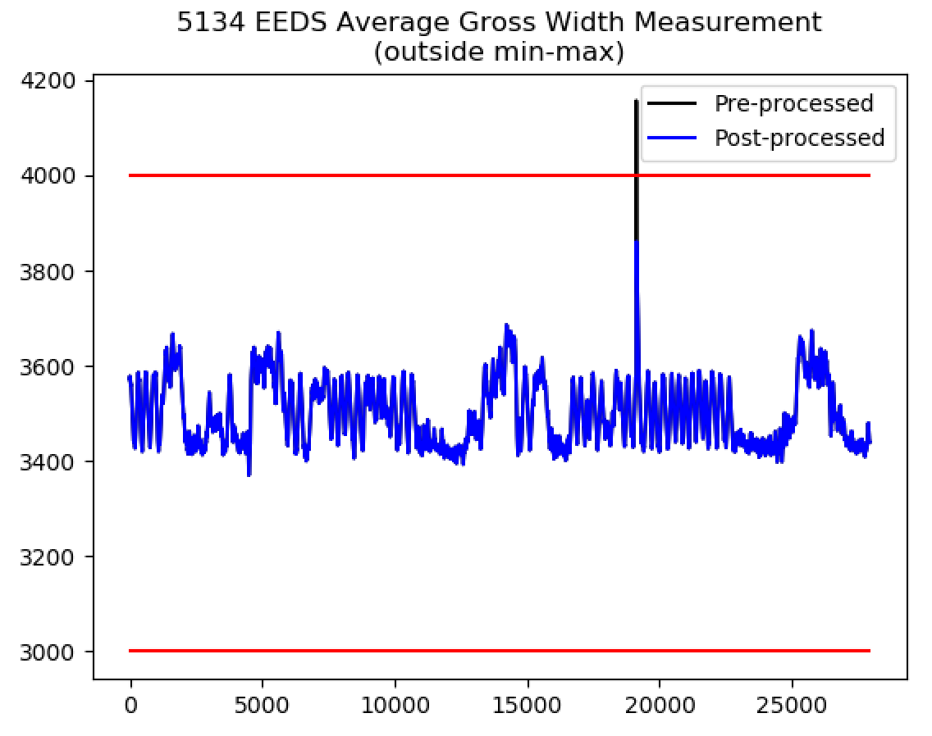
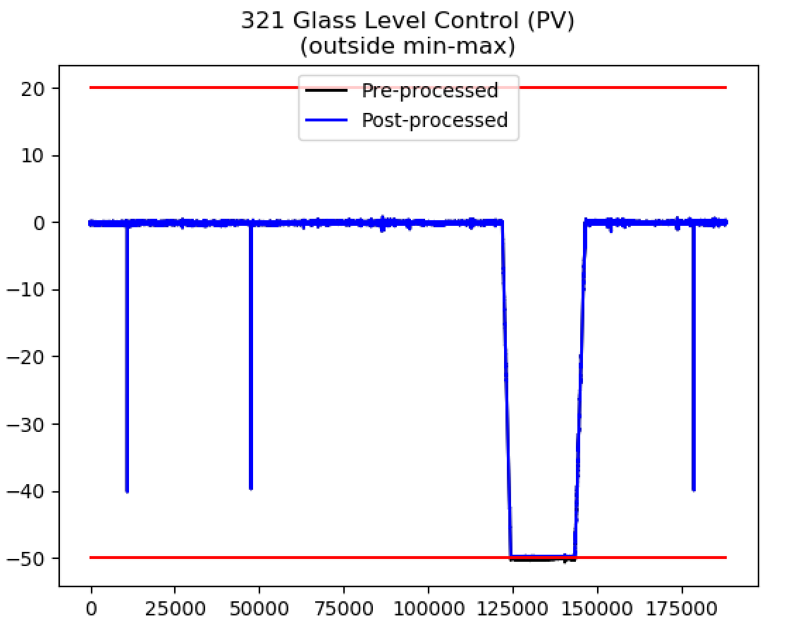
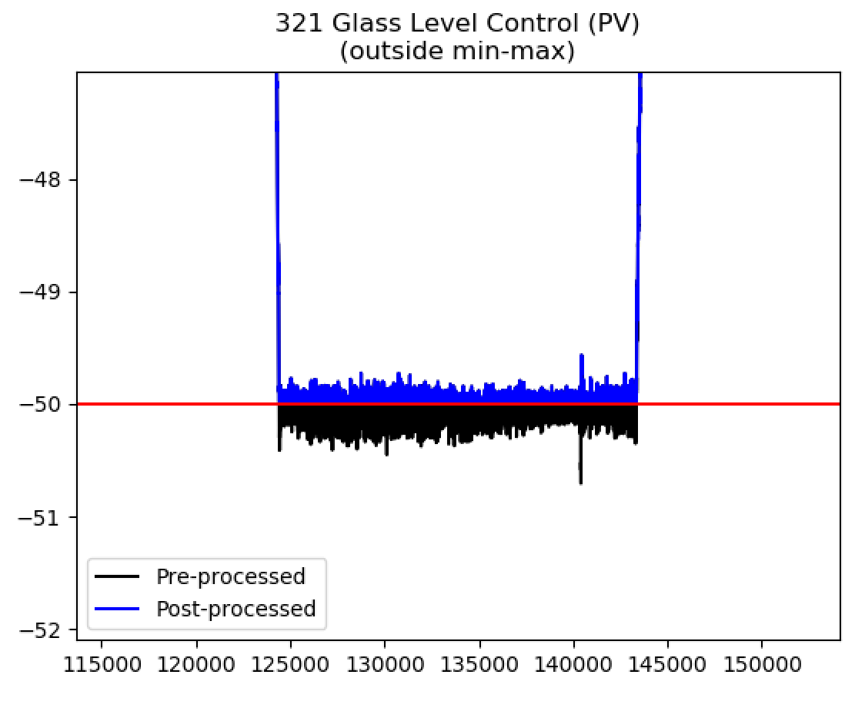
Processing Engineering Limits (1)

Slide 5
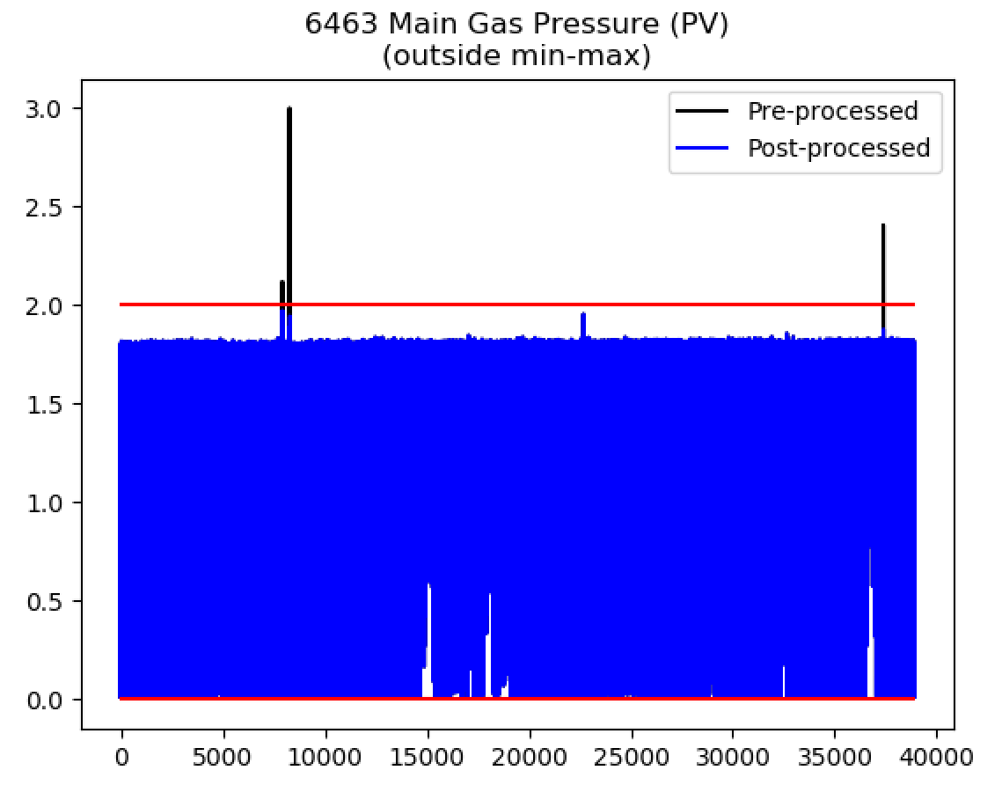
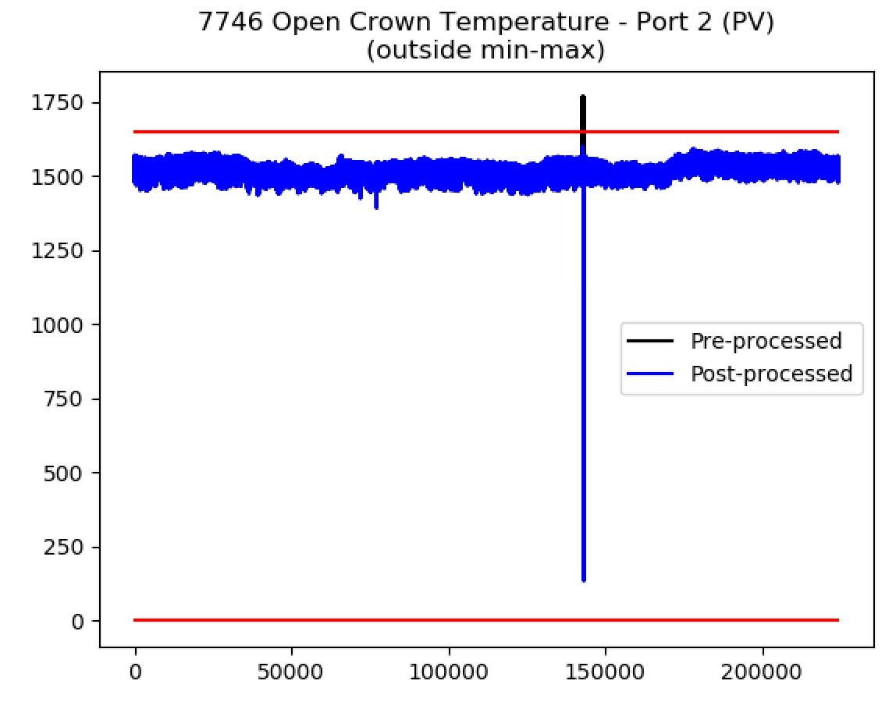
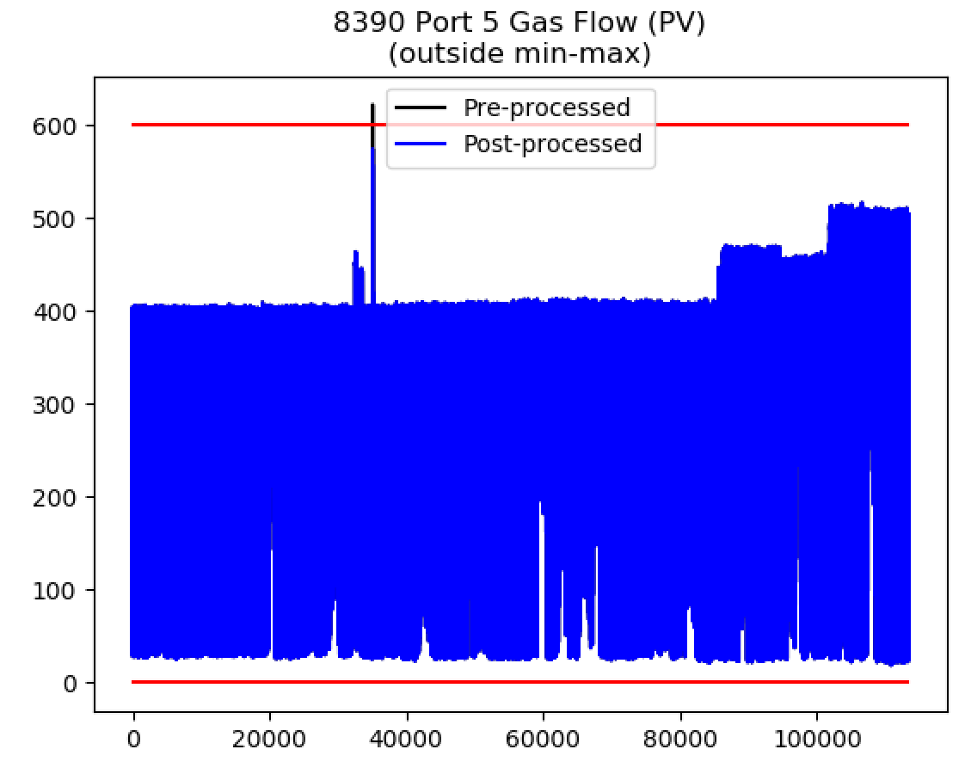
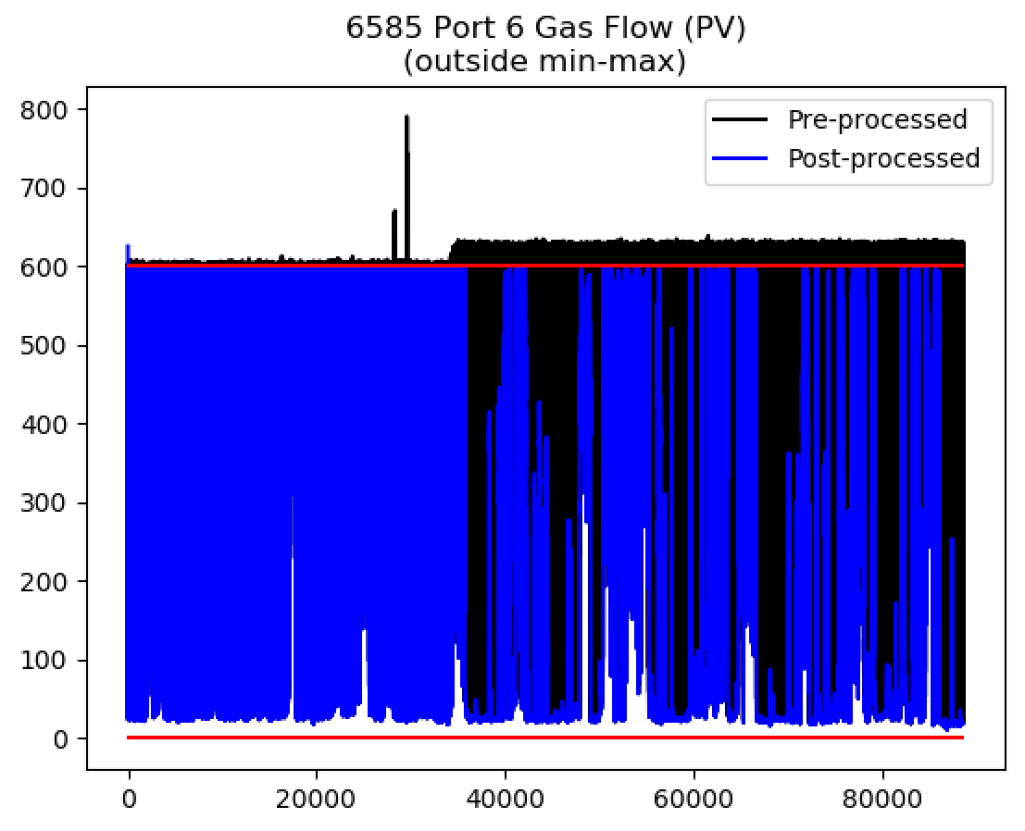
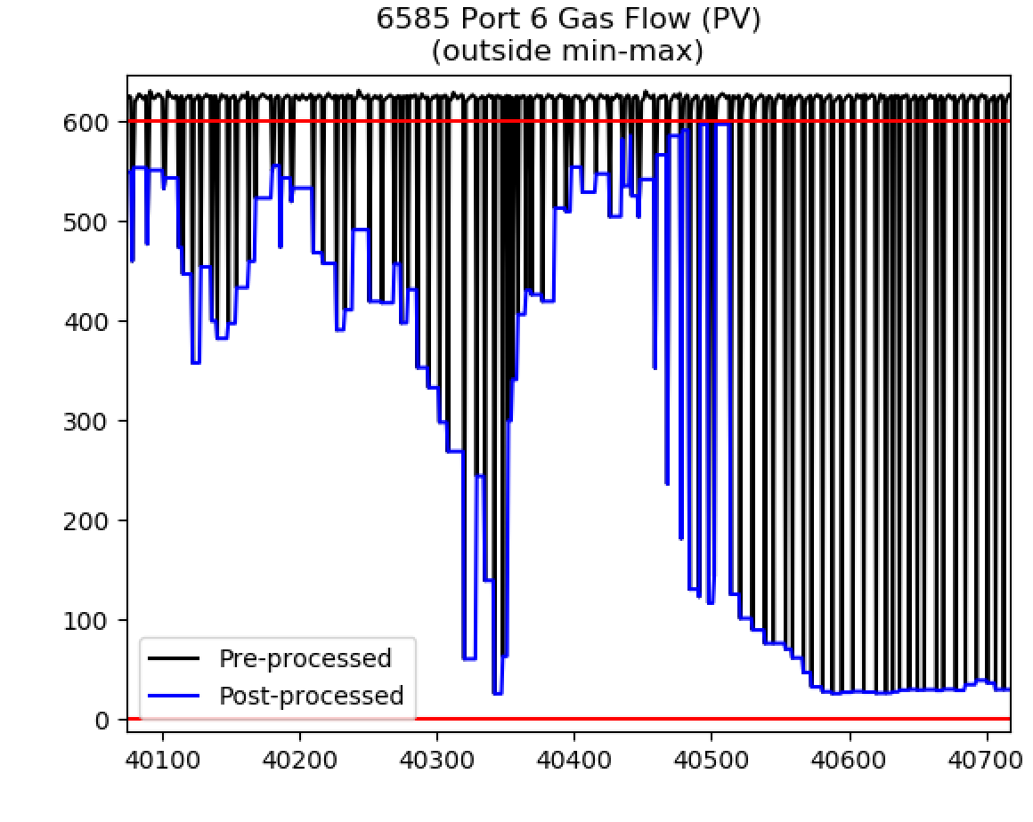
Processing Engineering Limits (1)
Limit needs refining?
Limit moved.

Slide 6
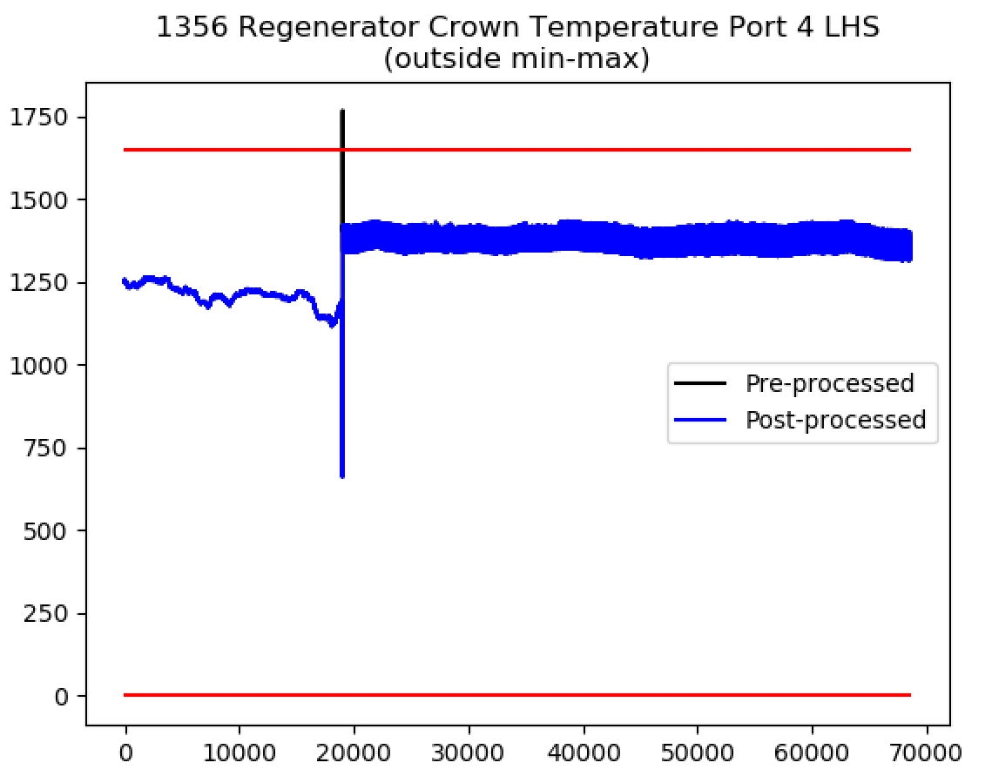
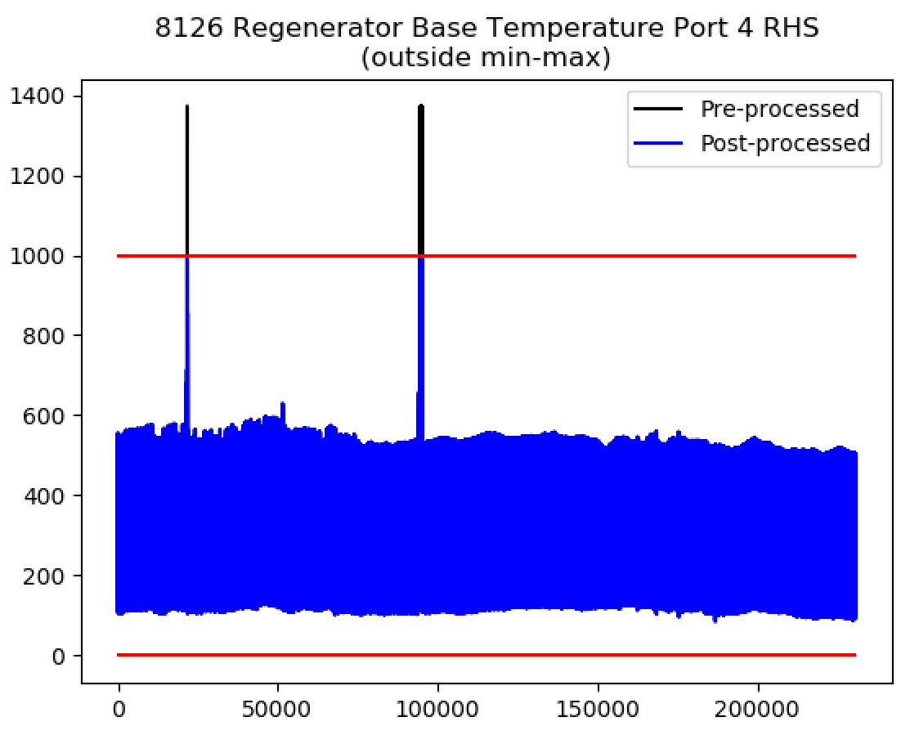
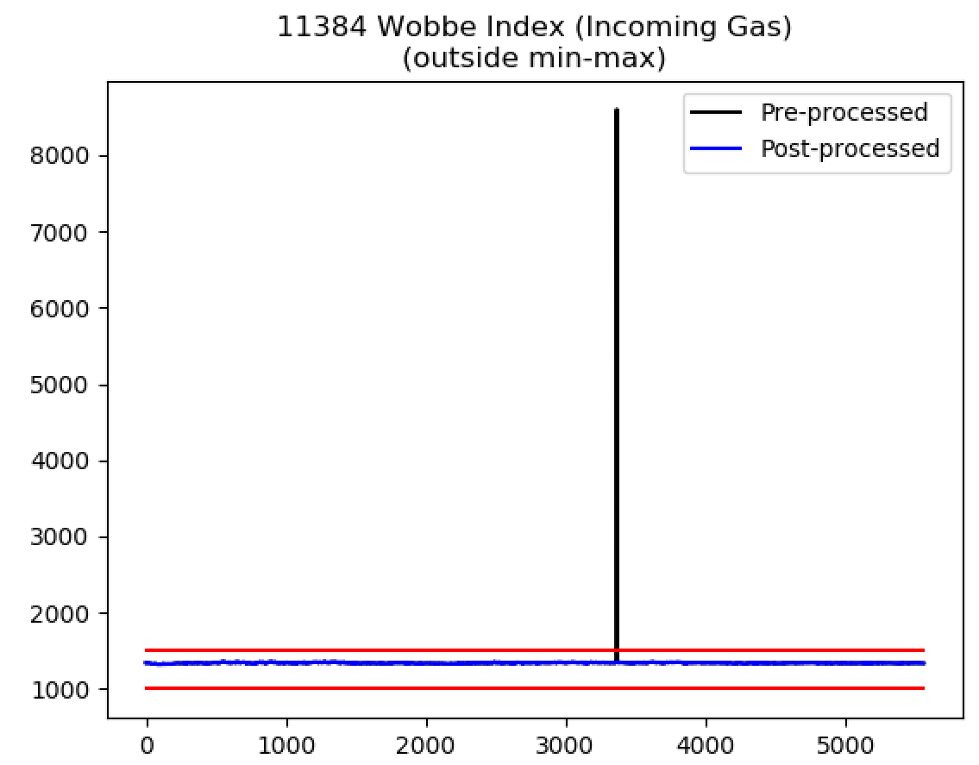
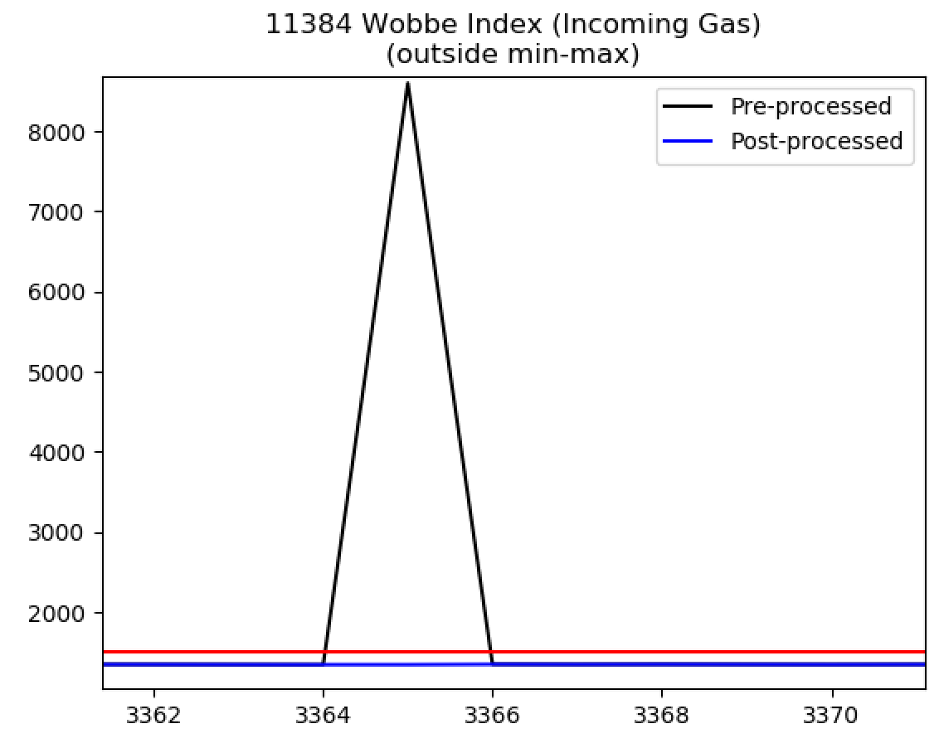
Processing Engineering Limits (1)

Slide 7
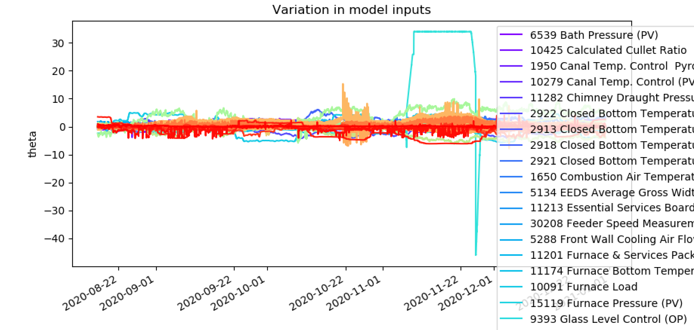
Processing Engineering Limits (1)

Slide 8
Processing Engineering Limits (1)

Slide 9
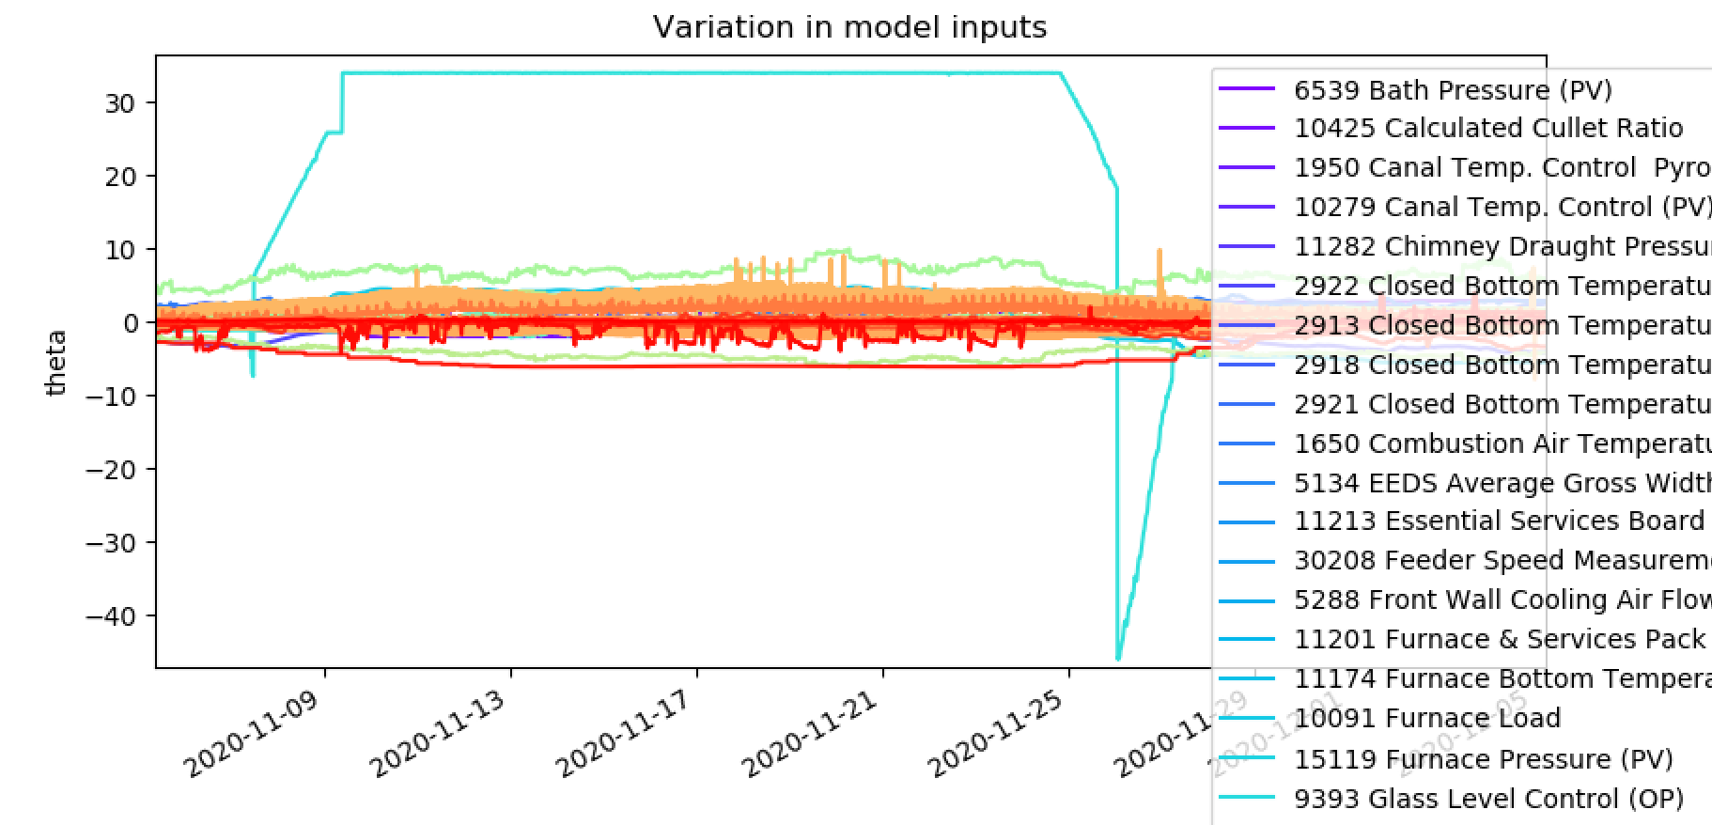
Processing Engineering Limits (1)

Slide 10
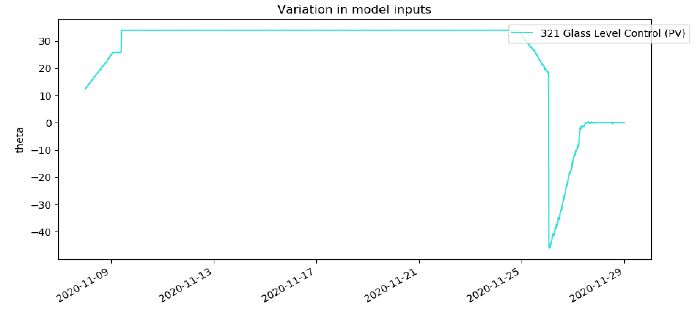
Processing Engineering Limits (1)

Slide 11
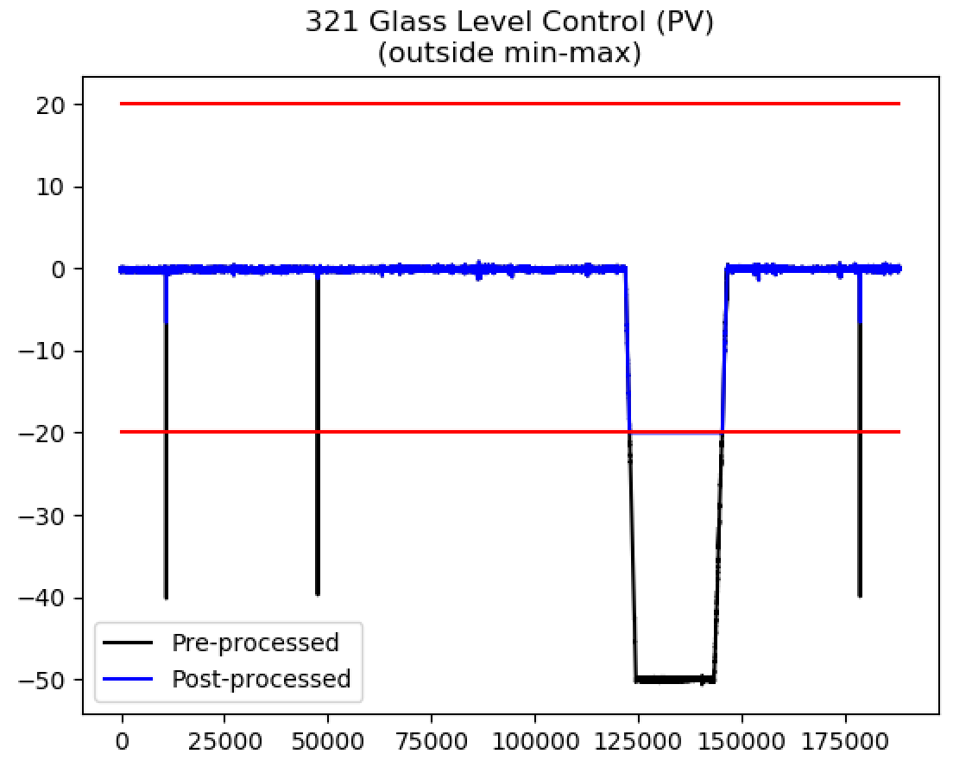
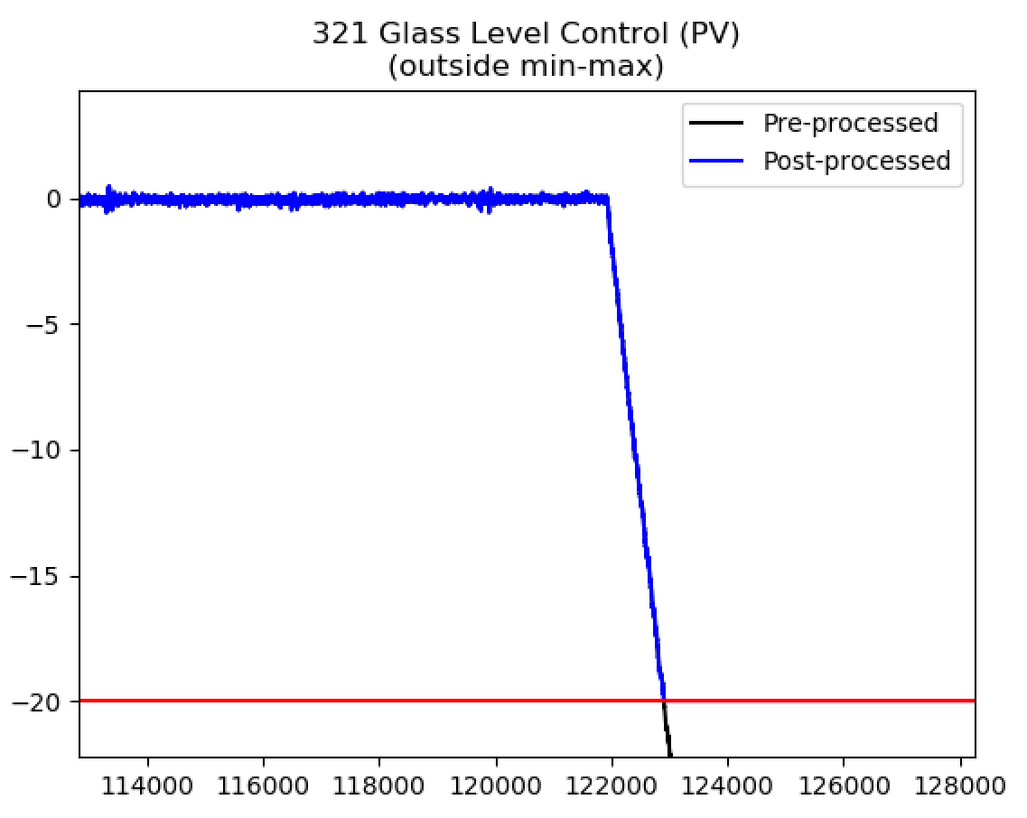
Processing Engineering Limits (2)
Tried to change the lower limit of the Glass Level Control (PV) to see if this would help.
Gradual ‘ramping down’ means that our ‘use the previous value’ approach doesn’t work.
Did something strange happen to this between 2020-11-08 and 2020-11-29?
For now we have decided to ignore this signal completely.

Slide 12
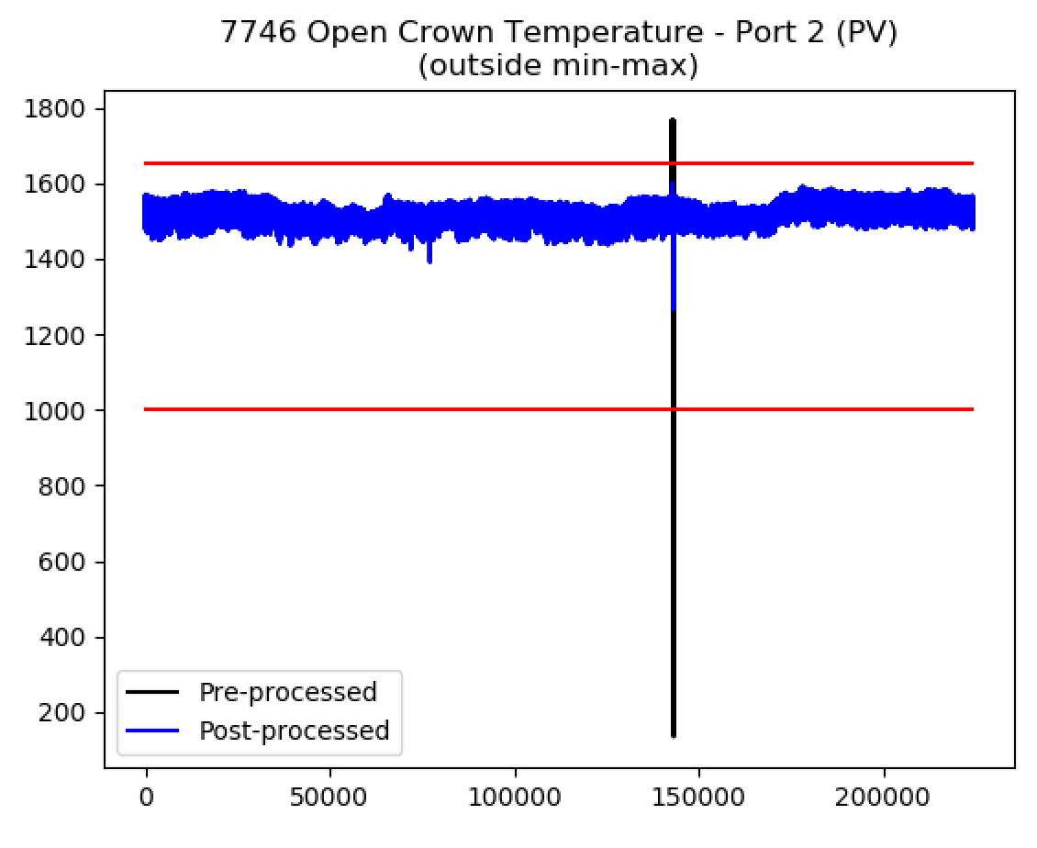
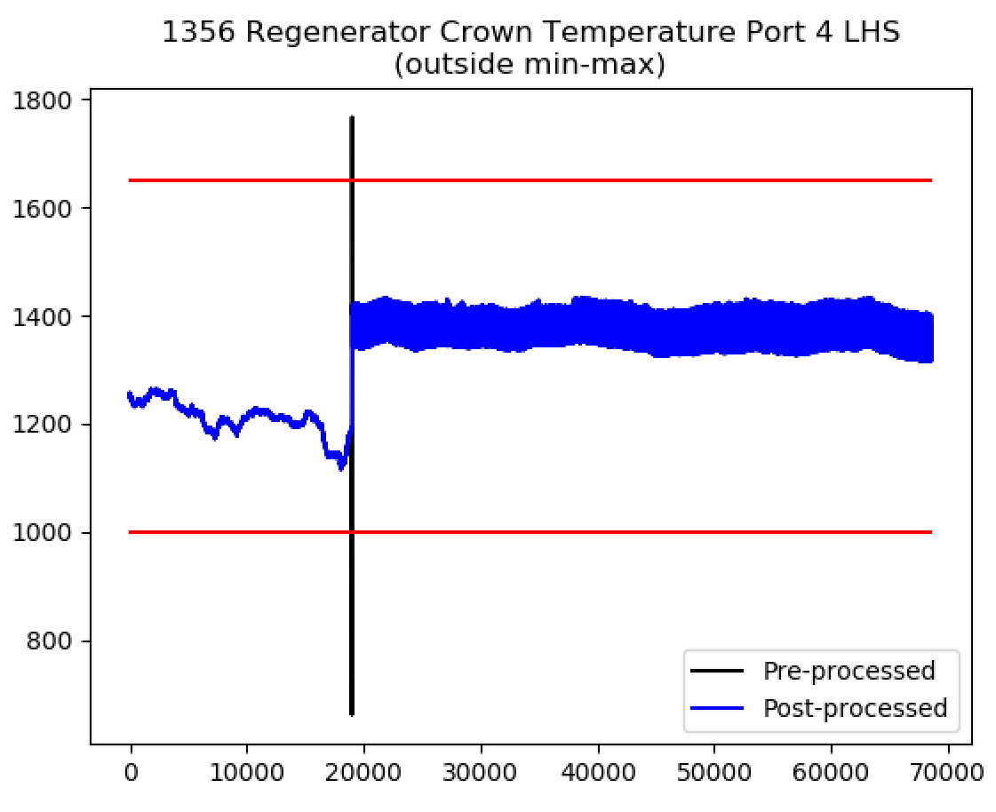
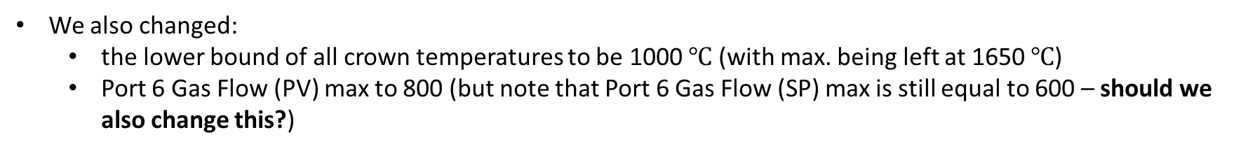
Processing Engineering Limits (2)
We also changed:
the lower bound of all crown temperatures to be 1000 $℃$ (with max. being left at 1650 $℃$)
Port 6 Gas Flow (PV) max to 800 (but note that Port 6 Gas Flow (SP) max is still equal to 600 – should we also change this?)
With these changes made, the model does not experience any instabilities over dataset 3.
These are the results that are shown in the video:
Furnace AI 2021-03-29
All results (parameters and model inputs) are in
regression_online_results_2021-03-28.xlsx

Slide 13
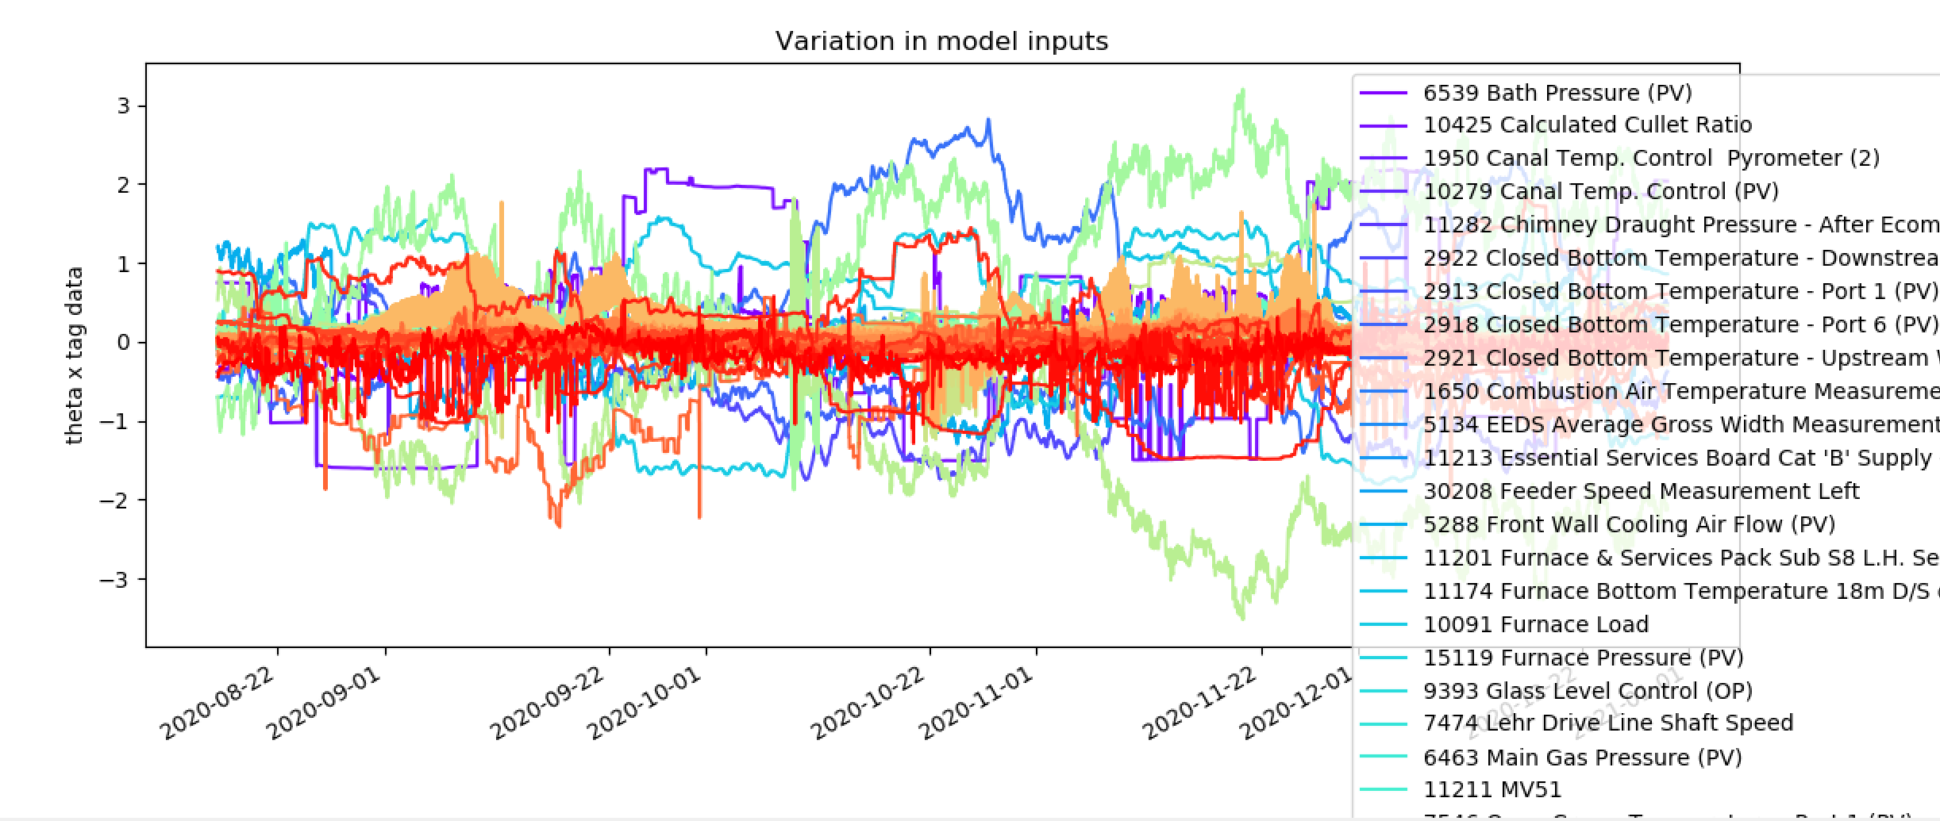
Important Inputs
Input limit = 0

Slide 14
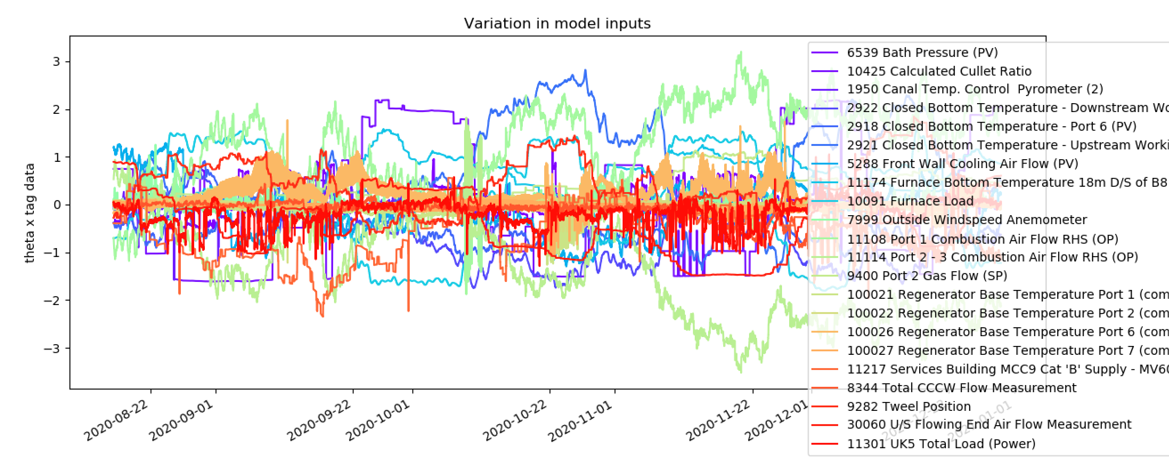
Important Inputs
Input limit = 1

Slide 15
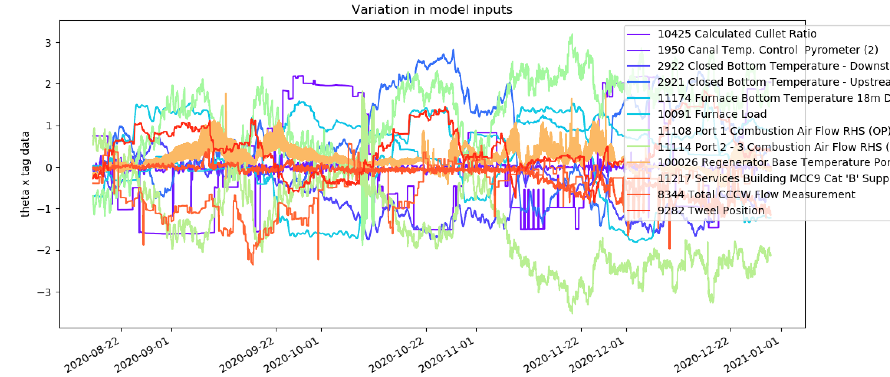
Important Inputs
Input limit = 1.5

Slide 16
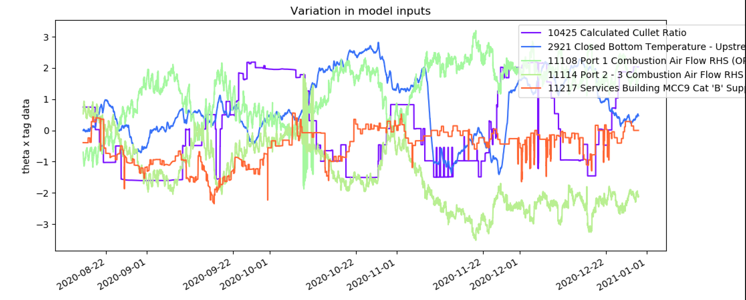
Important Inputs
Input limit = 2

Slide 17
Important Inputs
Input limit = 2
Effectively a constant or is this important?

Slide 18
Important Inputs
Input limit = 2
A surprise?

Slide 19
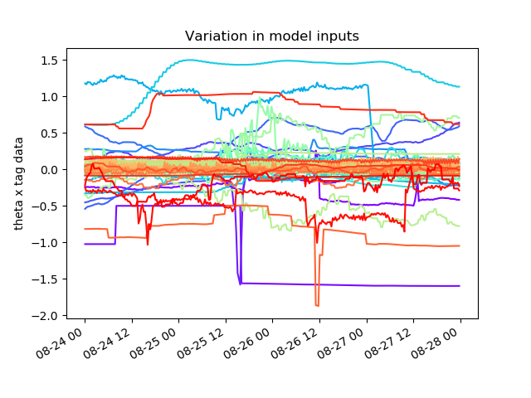
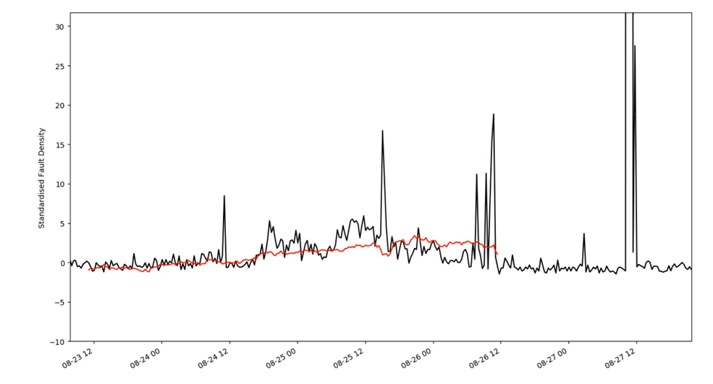
Model inputs - interesting regions
2020-08-24 to 2020-08-28

Slide 20
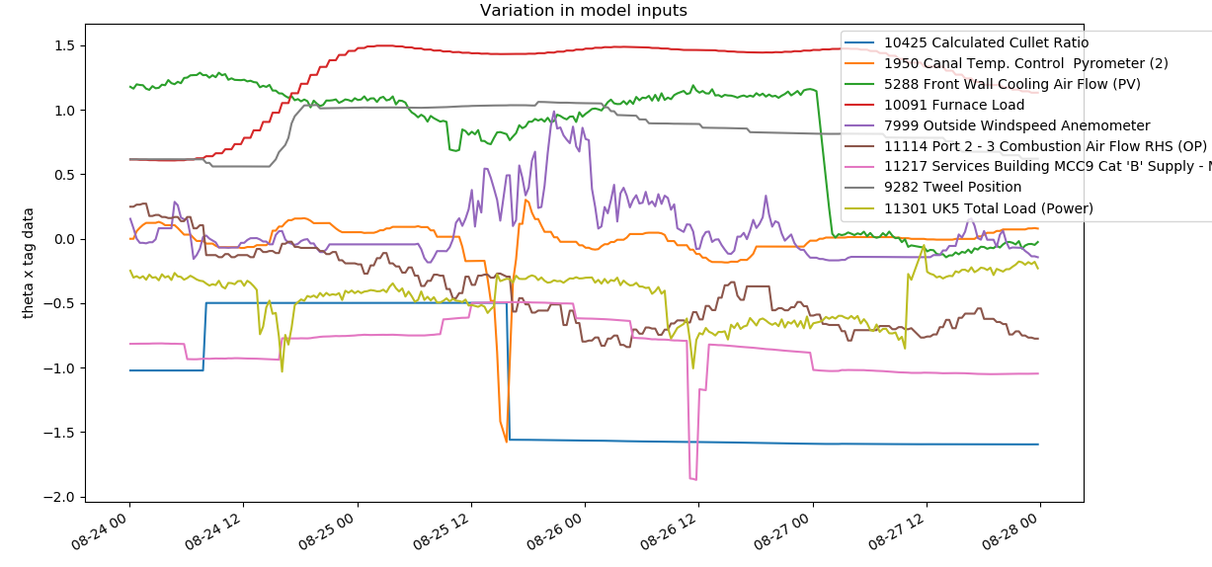
Model inputs - interesting regions
2020-08-24 to 2020-08-28

Slide 21
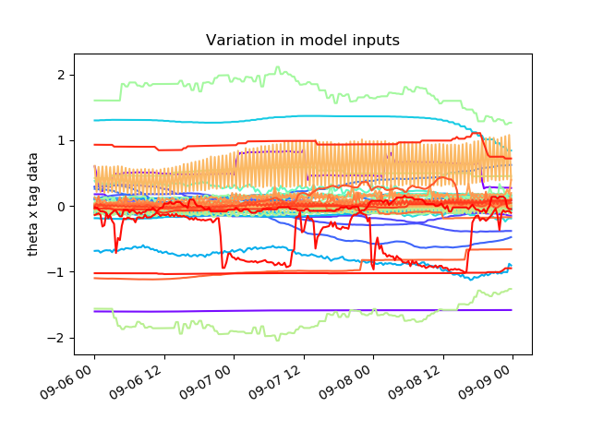
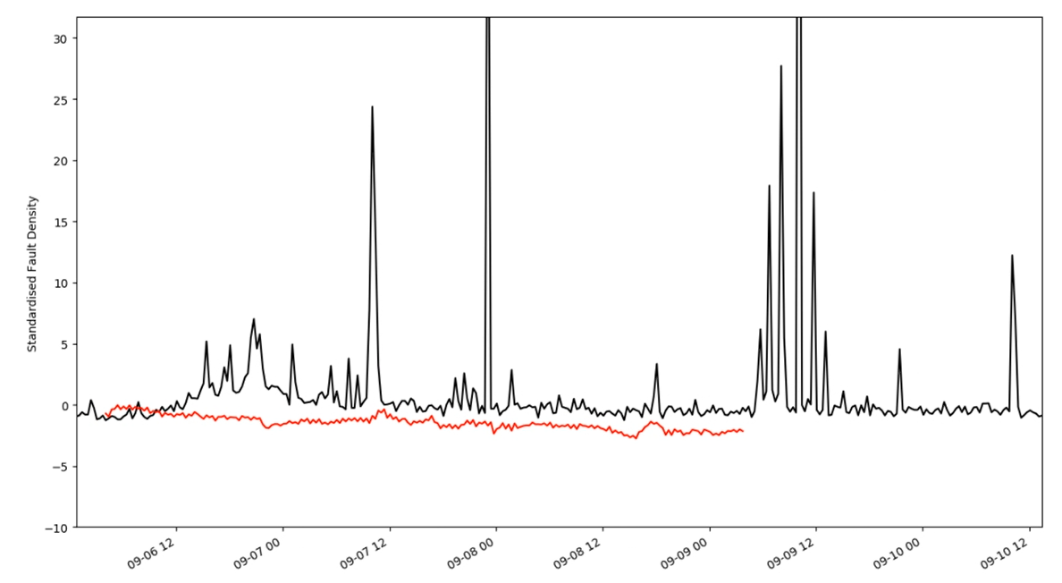
Model inputs - interesting regions
2020-09-06 to 2020-09-09

Slide 22
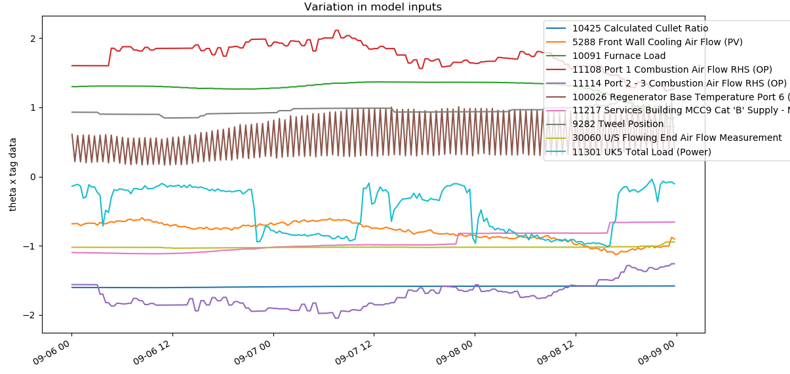
Model inputs - interesting regions
2020-09-06 to 2020-09-09

Slide 23
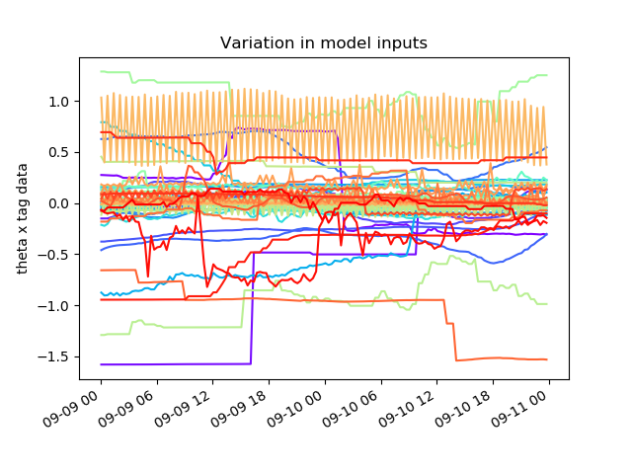
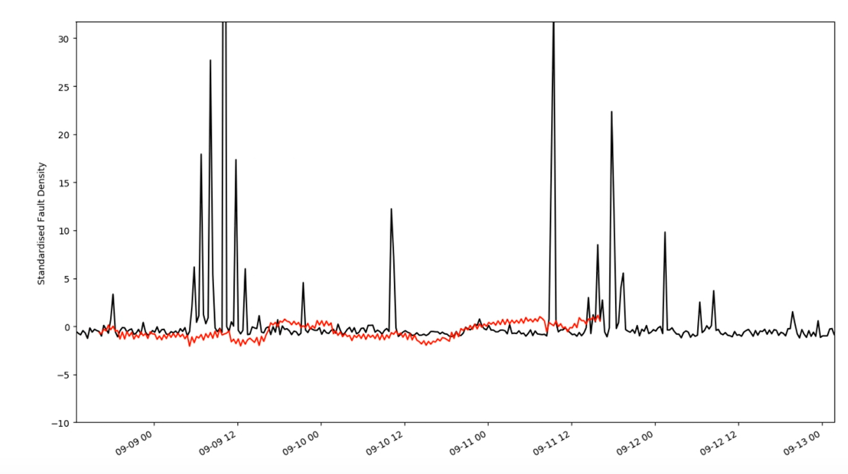
Model inputs - interesting regions
2020-09-09 to 2020-09-11

Slide 24
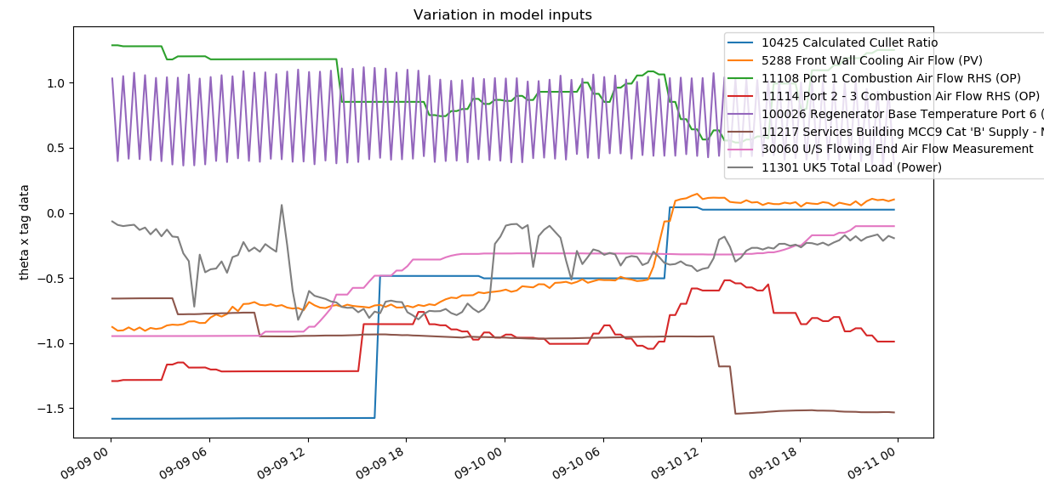
Model inputs - interesting regions
2020-09-09 to 2020-09-11

Slide 25
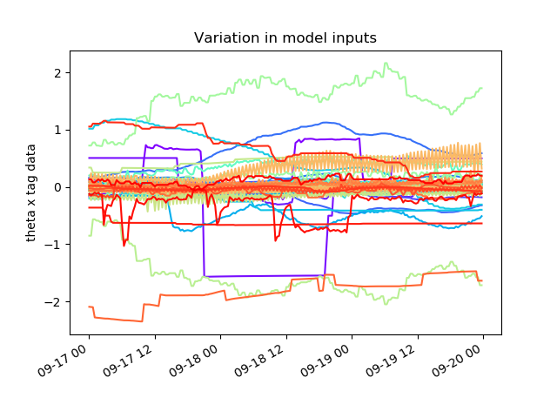
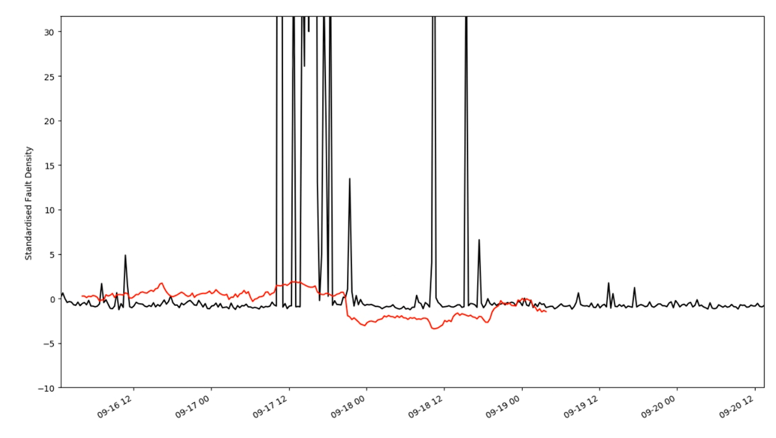
Model inputs - interesting regions
2020-09-17 to 2020-09-20

Slide 26
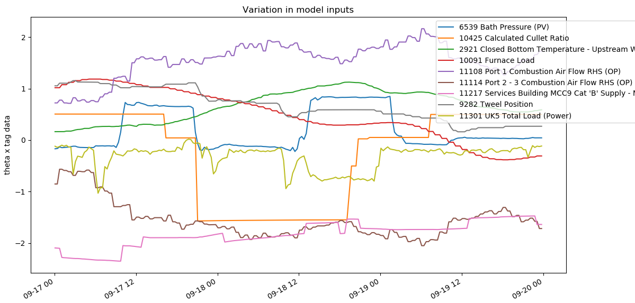
Model inputs - interesting regions
2020-09-17 to 2020-09-20

Slide 27
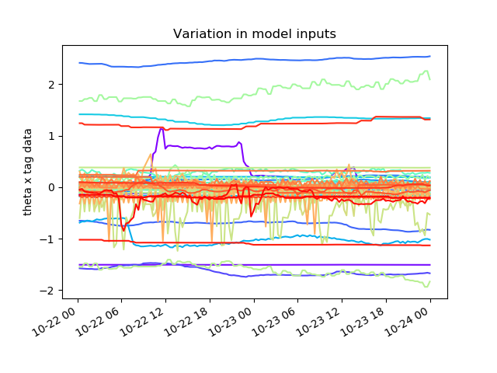
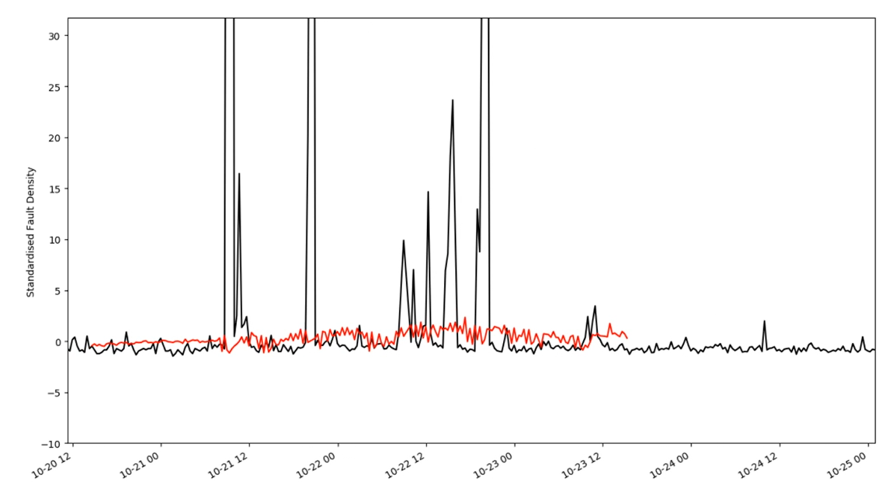
Model inputs - interesting regions
2020-10-22 to 2020-10-24

Slide 28
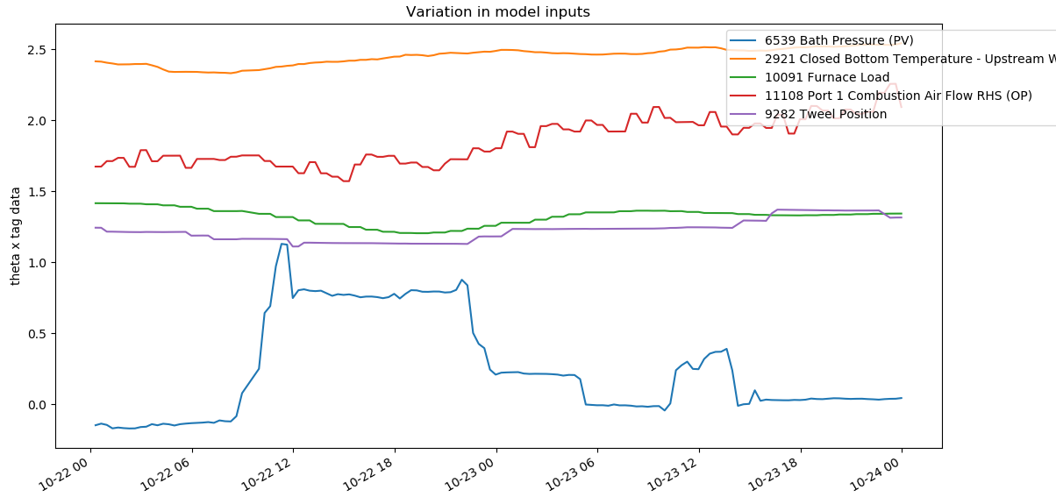
Model inputs - interesting regions
2020-10-22 to 2020-10-24

Slide 29
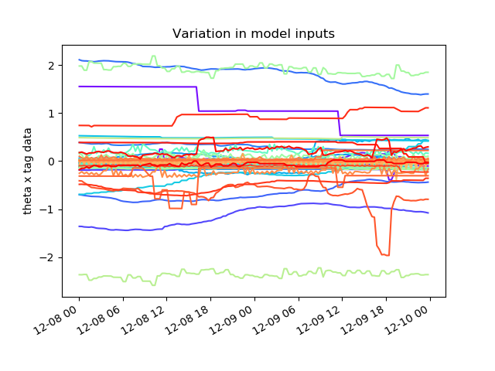
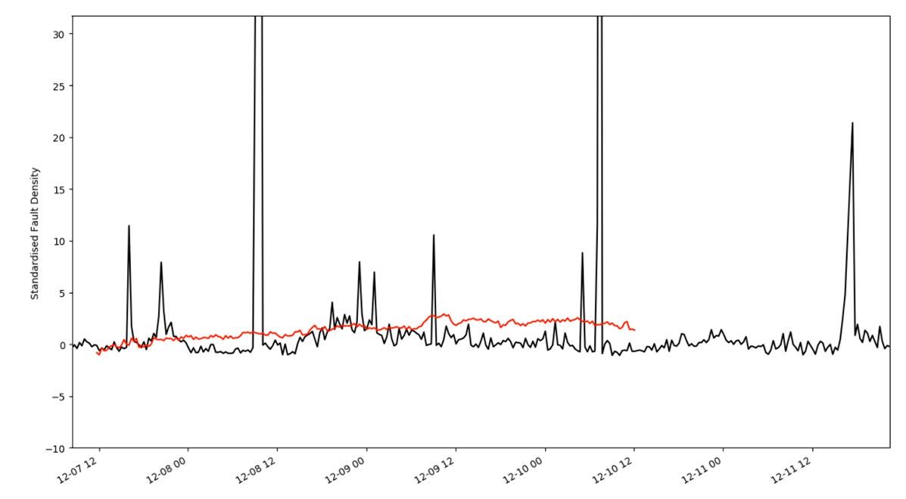
Model inputs - interesting regions
2020-12-08 to 2020-12-10

Slide 30
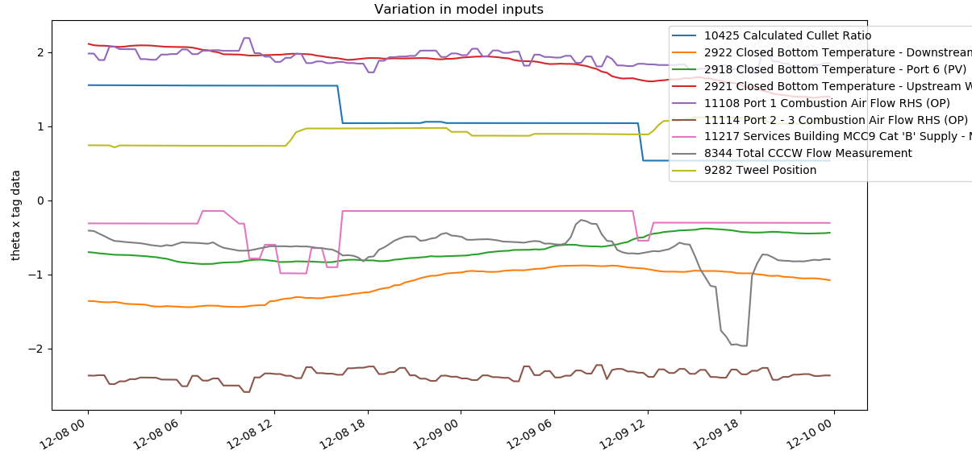
Model inputs - interesting regions
2020-12-08 to 2020-12-10

Slide 31
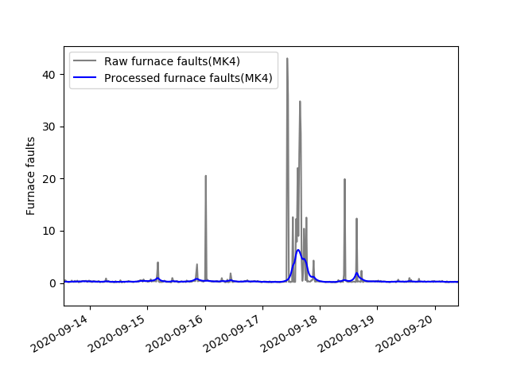
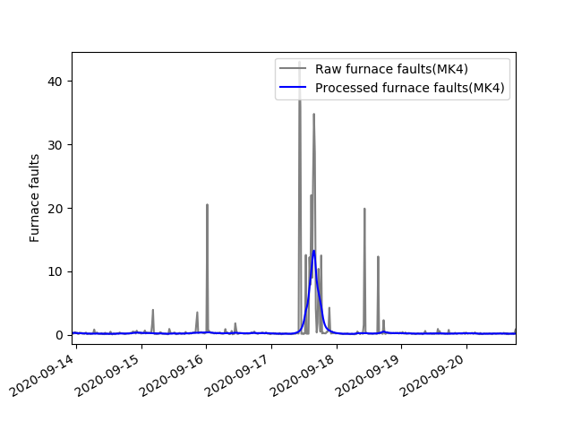
Mark 4 data filtering
3 sigma from mean calculated for the entire distribution
3 sigma from mean calculated sequentially
We have these little bumps

Slide 32
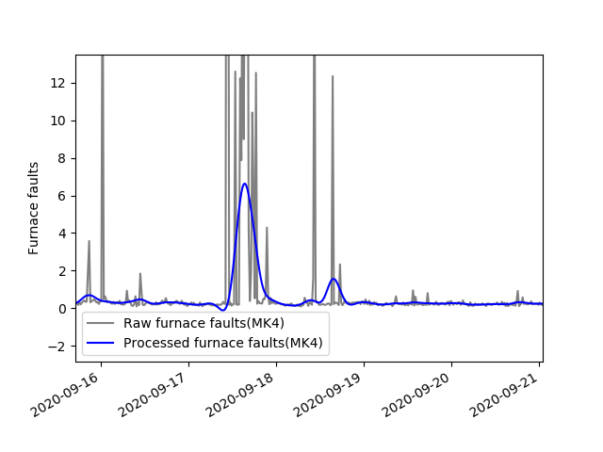
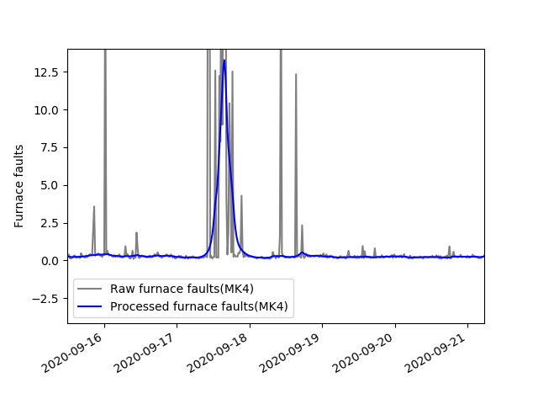
Mark 4 data filtering
3 sigma from mean calculated for the entire distribution
3 sigma from mean calculated sequentially
12 hrs
40 mins

Slide 33

Mark 4 data filtering
3 sigma from mean calculated using the entire distribution
3 sigma from mean calculated using furnace faults <10
12 hrs
40 mins

Slide 34


Mark 4 data filtering
3 sigma from mean calculated for the entire distribution
3 sigma from mean calculated sequentially
4 hrs

Slide 35

Mark 4 data filtering
3 sigma from mean calculated for the entire distribution
3 sigma from mean calculated using furnace faults <10

Slide 36


Mark 4 data filtering
3 sigma from mean calculated for the entire distribution
3 sigma from mean calculated sequentially
Are these spikes or not?

Slide 37


Mark 4 data filtering
3 sigma from mean calculated for the entire distribution
3 sigma from mean calculated sequentially
Are these spikes or not?

Slide 38

Estimating time lags
We generated N = 500 samples of the time lags, from a Gaussian distribution as follows,
$$time lags=time la{gs}_{Pilkington}+s r$$
$$r∼N\left({0,1}^{2}\right)$$
Defining $s=1$ hour
Tag: 8122 Regenerator Base Temperature Port 1 LHS
Time lag provided = 36 hours
Min = 35, Max = 37

Slide 39

Estimating time lags
We generated N = 1500 samples of the time lags, from a uniform distribution,
$$time lags∼Uniform(TimeLags_{Pilkington}, TimeLags_{Pilkington}+s)$$
We assumed that the tags with the maximum time lag (in this case 36 hours) can have a time lag up to 96 hours (4 days). For instance,
Tag: 8122 Regenerator Base Temperature Port 1 LHS
Time lag provided = 36 hours
Therefore, $s=72$ (hours).
Min = 36 hours, Max = 96 hours.

Slide 40



N = 500 From a Gaussian distribution $$± 1 hour$$
MSE = 0.1155
N = 1500 From a Uniform distribution
Up to 4 days
MSE = 0.1189

Slide 41


N = 500 From a Gaussian distribution
MSE = 0.1155
N = 1500 From a Uniform distribution
MSE = 0.1189

Slide 42

Estimating time lags
Next Steps:
Training using raw fault density? Ignoring faults > $x$ faults/10m2?
Eliminate 321 Glass Level Control (PV)
Samples drawn from a Uniform distribution reducing the sample space and increasing the number of simulations.

Slide 43






Linear Dynamical System
$$y_{1}$$
$$y_{2}$$
$$y_{3}$$
…
$$x_{1}$$
$$x_{2}$$
$$x_{3}$$

Slide 44
Linear Dynamical System
(Note that this would be an auto-regressive model, though we are not using that now)
$$y_{1}$$
$$y_{2}$$
$$y_{3}$$
…
$$x_{1}$$
$$x_{2}$$
$$x_{3}$$

Slide 45
Linear Dynamical System
But as we predict further into the future, the inputs that have shorter time lags will become uncertain.
We call these hidden or latent inputs.
$$y_{1}$$
$$y_{2}$$
$$y_{3}$$
…
$$x_{1}$$
$$x_{2}$$
$$x_{3}$$

Slide 46


Linear Dynamical System
$$z_{2}$$
But as we predict further into the future, the inputs that have shorter time lags will become uncertain.
We call these hidden or latent inputs.
At each increment into the future, we look at which inputs are now uncertain (the hidden inputs).
These will increase as we look further into the future (unique to this problem, I think).
$$z_{3}$$
$$y_{1}$$
$$y_{2}$$
$$y_{3}$$
…
$$x_{1}$$
$$x_{2}$$
$$x_{3}$$

Slide 47
Linear Dynamical System
$$z_{2}$$
Linear Dynamical System; we assume that predictions of the future hidden inputs can be made using the previous observed and hidden inputs.
We are not restricted to this structure; it might be more useful to initially consider something simpler and think about how it would operate in reality.
$$z_{3}$$
$$y_{1}$$
$$y_{2}$$
$$y_{3}$$
…
$$x_{1}$$
$$x_{2}$$
$$x_{3}$$

Slide 48


Linear Dynamical System
$$z_{2}$$
$$z_{3}$$
$$z_{n}=Az_{n−1}+Bx_{n−1}+w_{n}$$
$$y_{n}=θ_{z}^{T}z_{n}+θ_{x}^{T}x_{n}+v_{n}$$
$$y_{1}$$
$$y_{2}$$
$$y_{3}$$
Should be able to update $A$, $B$, $θ_{z}$, $θ_{x}$ and the variance of the noise terms online.
Or, first, we could try something simpler…
…
$$x_{1}$$
$$x_{2}$$
$$x_{3}$$

Slide 49

Next Steps?
Results from latest model runs are now on the sharepoint
Can we learn from these?
Where the model worsens; change in furnace properties or inadequate model?
Batch training ignoring outliers
Diego has already started looking at this
Noisy model outputs:
Removing inputs?
Principal Component Analysis?
Predictions always greater than zero:
Sigmoid model: $\frac{1}{1+exp⁡(−θ^{T}x)}$ ?
Nonlinear and less interpretable but might be worth looking at?
Future predictions
LDS
Some quick results already!
This is actually a very simple neural network…

Slide 50
Next Steps?
Longer-term
Gateway meeting
Strategy for involving the Japanese team – detailed report?
Shall we continue with a predominantly linear (interpretable) approach despite potential for negative predictions?

